Slide 1
GenAI and OpenAI

Slide 2
LLM

Slide 3
GenAI

Slide 4
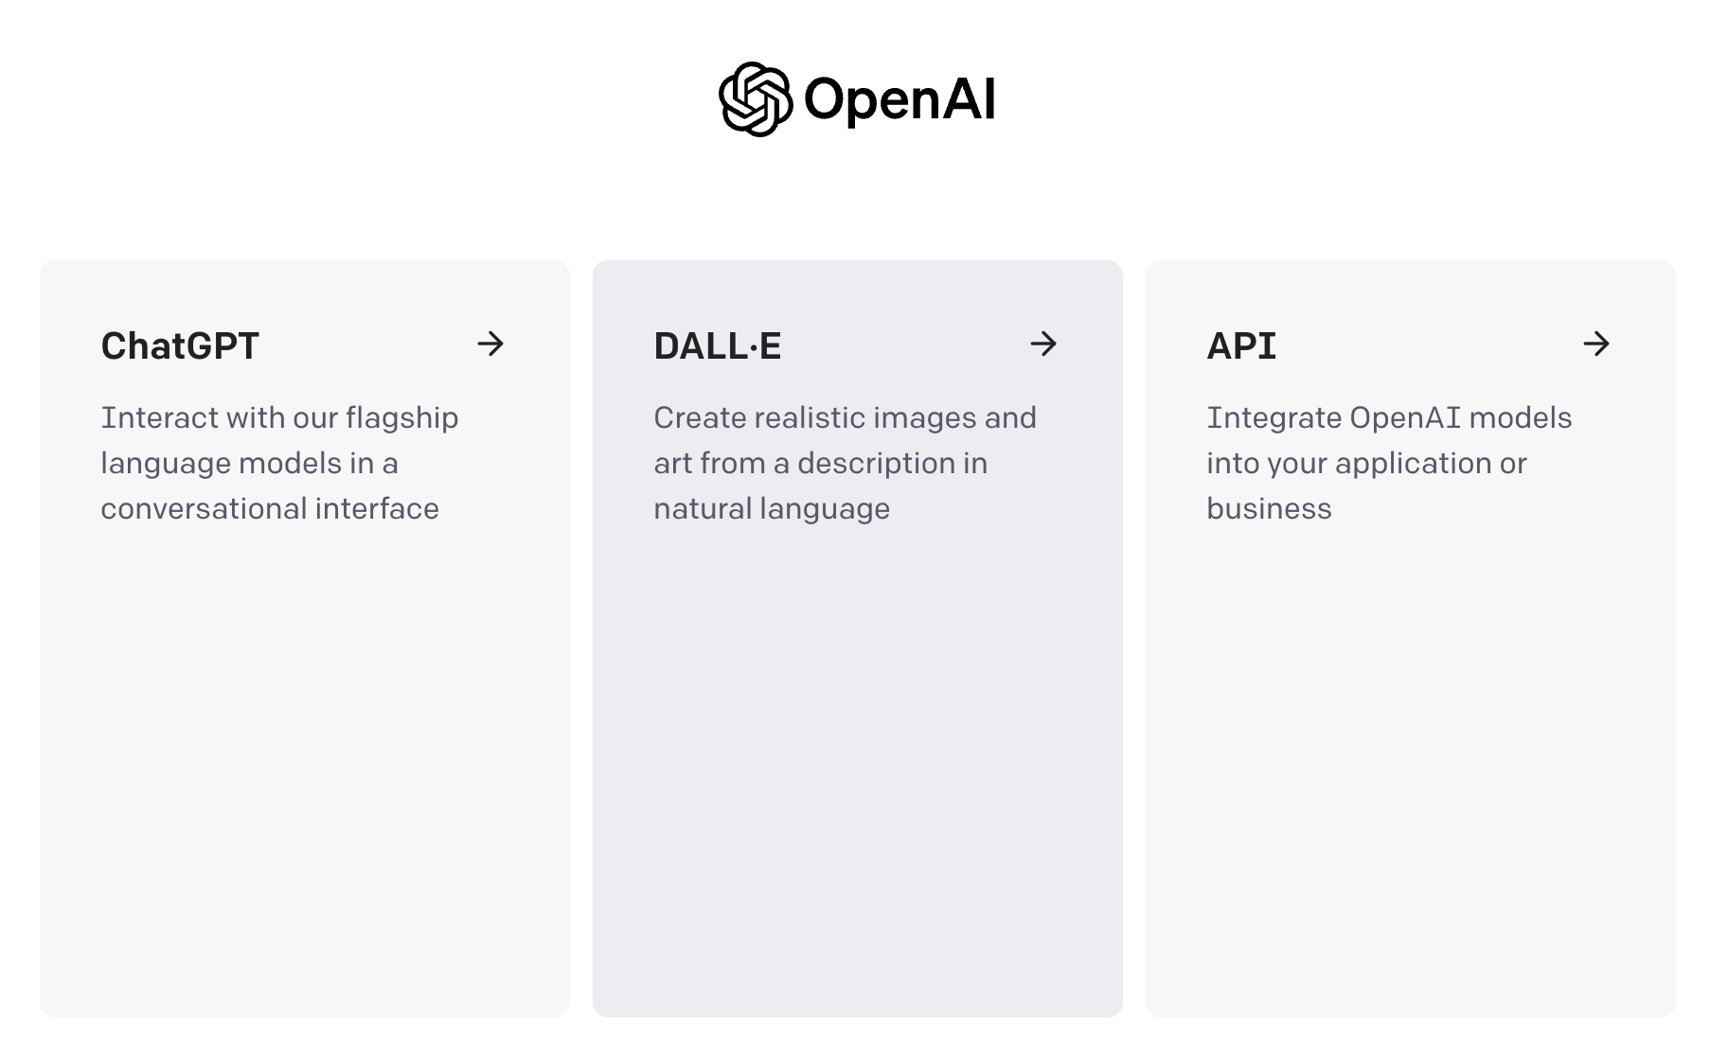

Slide 6
ChatGPT

Slide 7
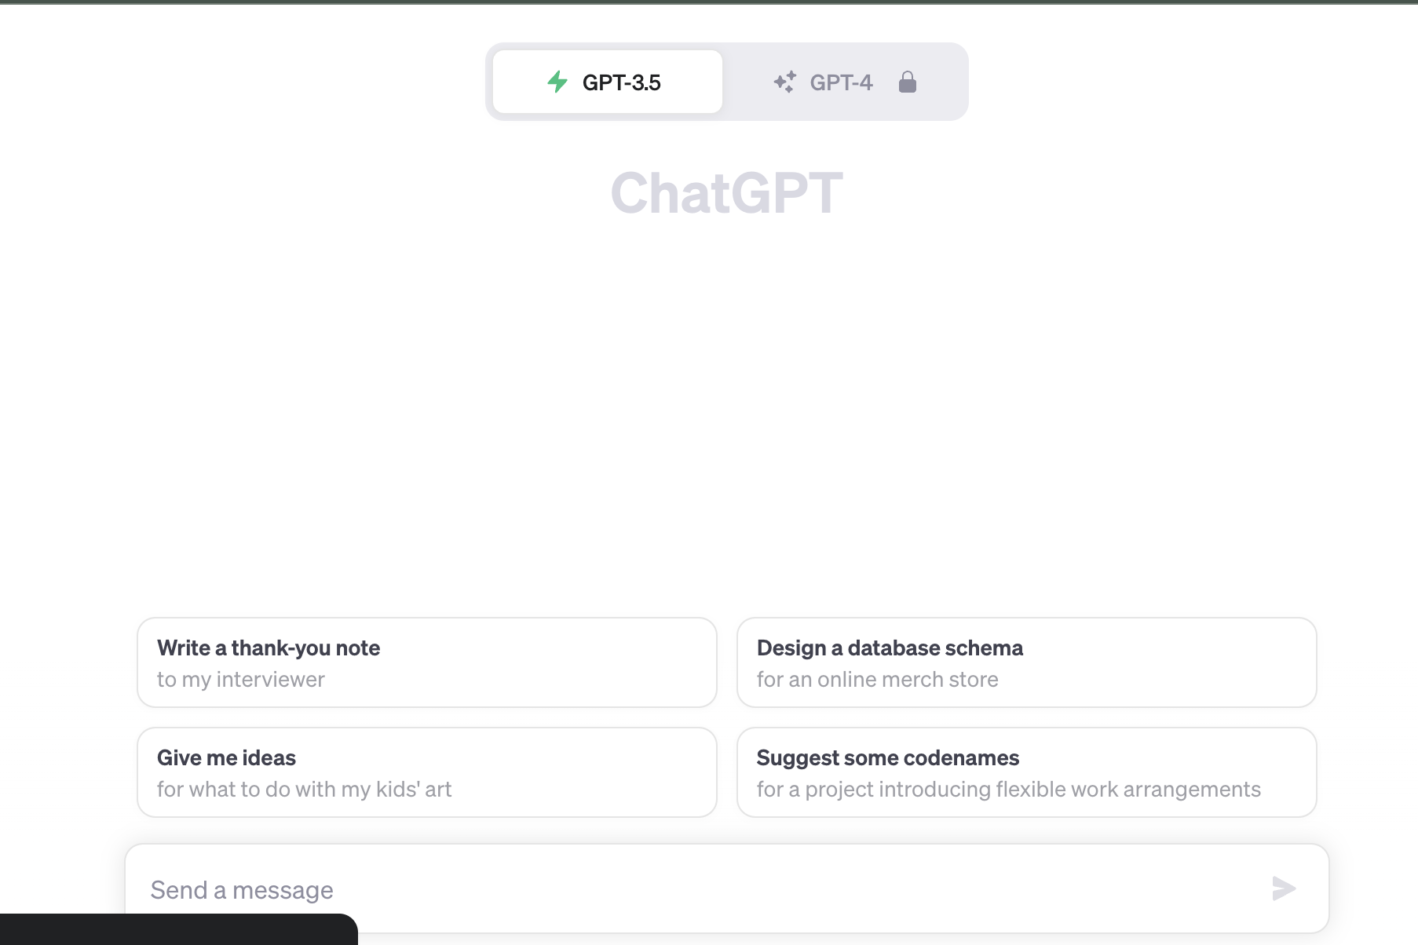

Slide 8
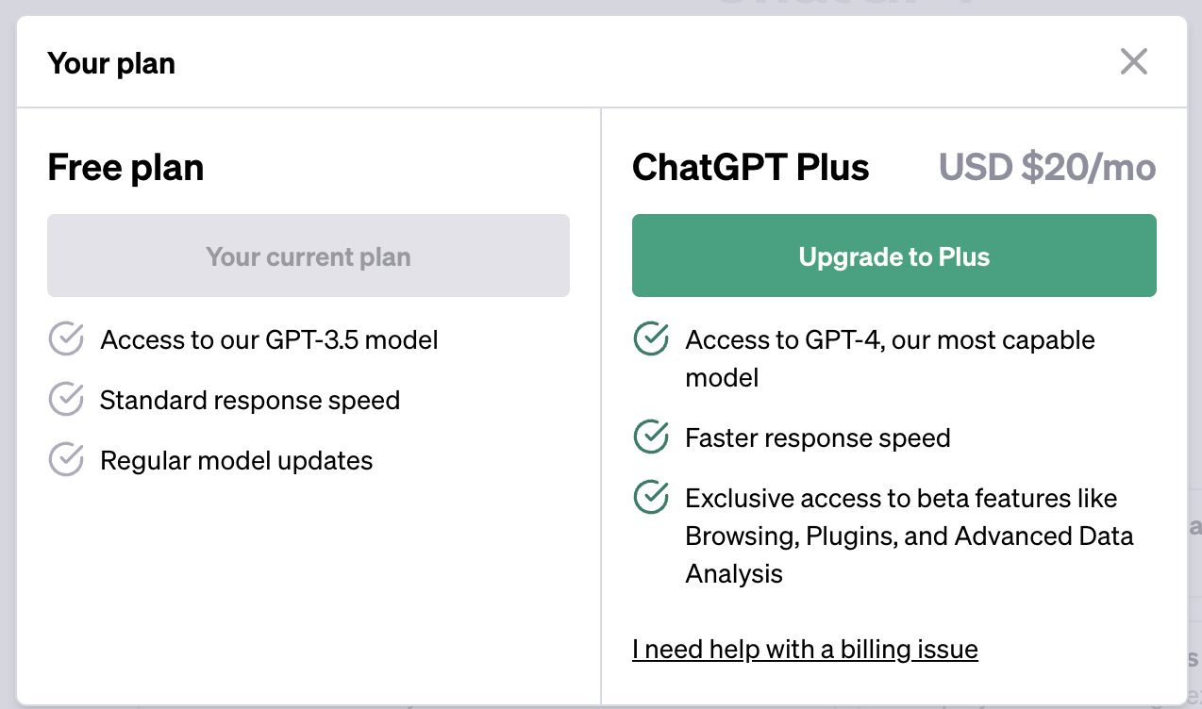
GPT 3.5 (Free)
GPT 4.0 (plus users)

Slide 9
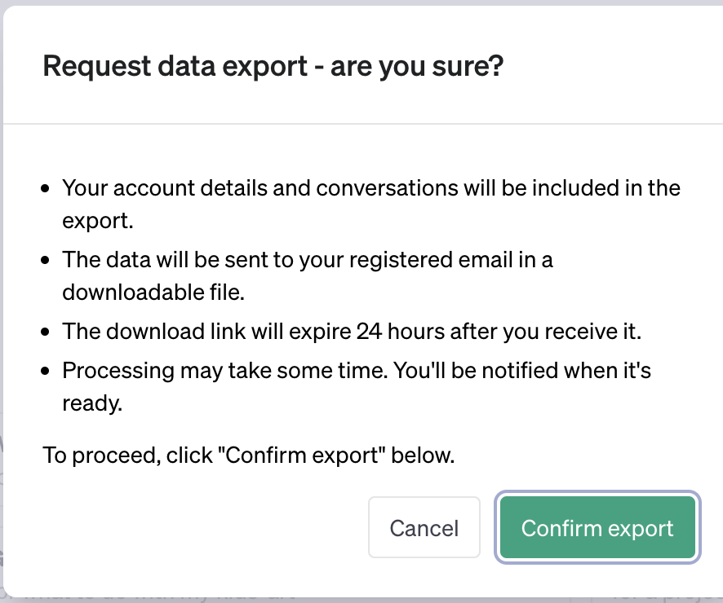
Setting:
General
Theme
Clear All chat
Data control
Export data
Delete Account

Slide 10
Hands on
Write a thank you note
Design a data base schema for an online store
Regenerate: Difference response as it is AI model and prediction is different

Slide 11
Share Chat
https://chat.openai.com/share/ef4d003a-3602-403e-ab90-8c57e5c6d62b
https://chat.openai.com/share/0226d6c0-0a2c-4383-ac59-688541e69208

Slide 12
DALL-E Image generation

Slide 13
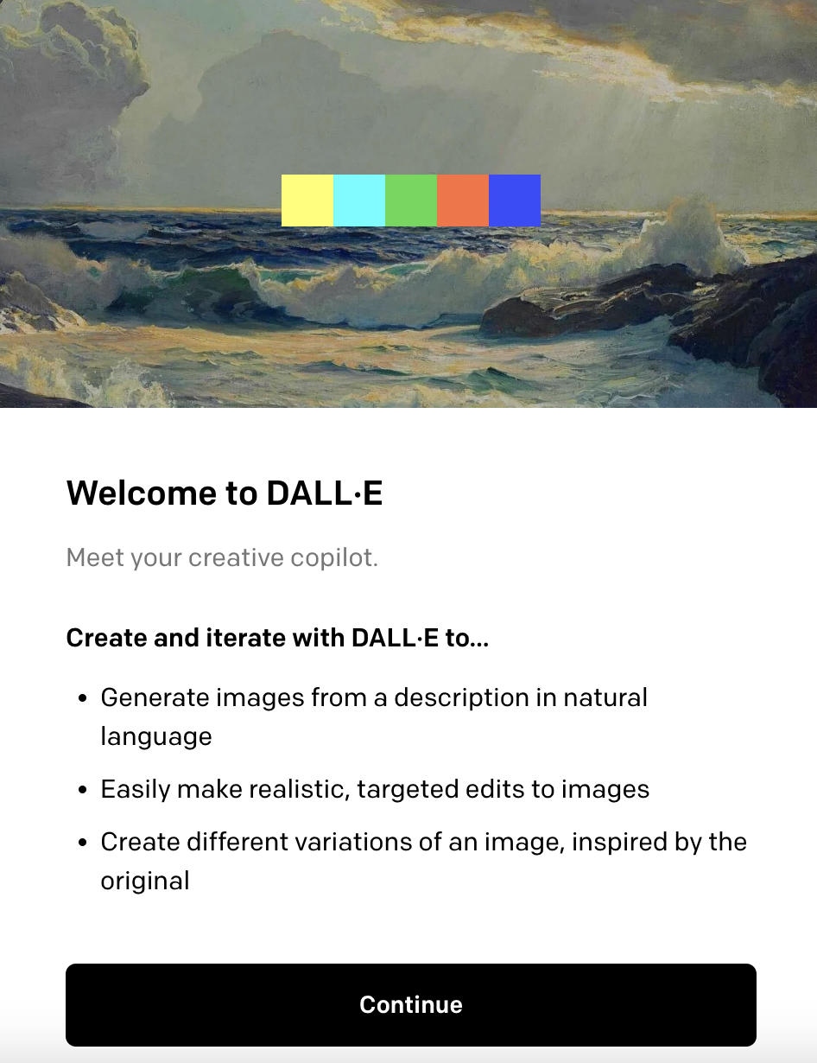
DAAL.E

Slide 14
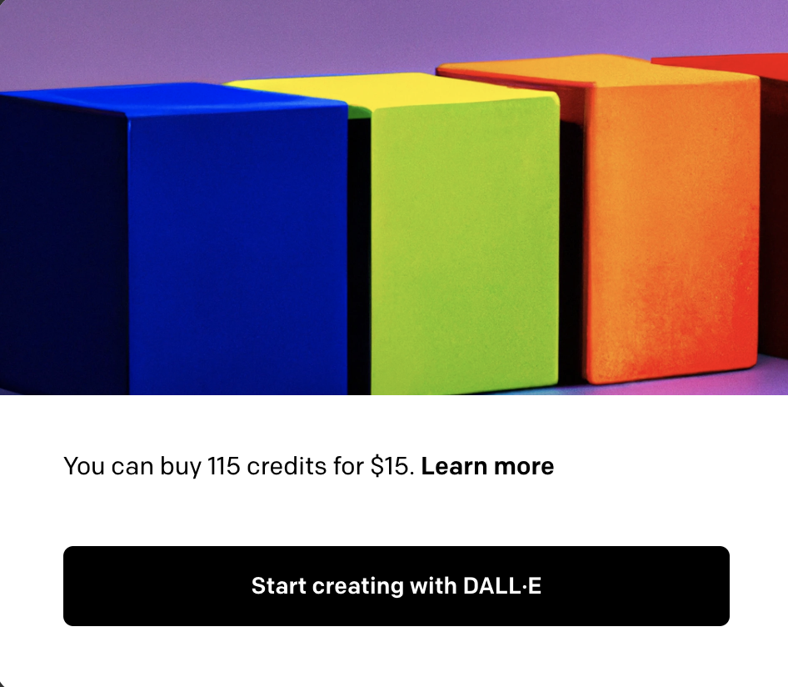

Slide 15
Surprise me
teddy bears shopping for groceries, one-line drawing
crayon drawing of several cute colorful monsters with ice cream cone bodies on dark blue paper
"a sea otter with a pearl earring" by Johannes Vermeer

Slide 17
API
pip install openai
Authorization: Bearer OPENAI_API_KEY

Slide 18
Example with python package
import os
import openai
openai.organization = "org-hSQxlI1F4hRHhtwigcsf6HXe"
openai.api_key = os.getenv("OPENAI_API_KEY")
openai.Model.list()

Slide 19
Making Request
YYou can paste the command below into your terminal to run your first API request. Make sure to replace $OPENAI_API_KEY with your secret API key.
curl https://api.openai.com/v1/chat/completions \
-H "Content-Type: application/json" \
-H "Authorization: Bearer $OPENAI_API_KEY" \
-d '{
"model": "gpt-3.5-turbo",
"messages": [{"role": "user", "content": "Say this is a test!"}],
"temperature": 0.7
}'

Slide 20
curl https://api.openai.com/v1/chat/completions \
-H "Content-Type: application/json" \
-H "Authorization: Bearer $OPENAI_API_KEY" \
-d '{
"model": "gpt-3.5-turbo",
"messages": [{"role": "user", "content": "Say this is a test!"}],
"temperature": 0.7
}'

